Slide 1
Problem 1

Slide 2
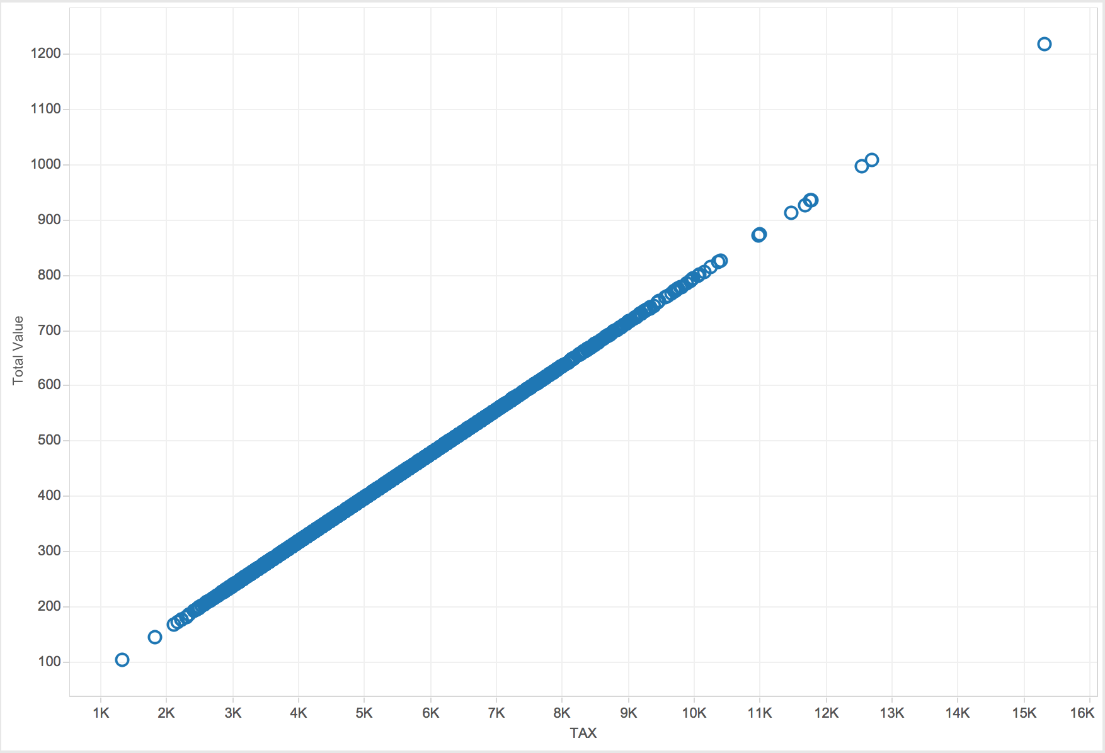
Figure1: Total Value vs Tax
Tax has a linear relationship with Total Value. Tax is used as a significant variable to predict Total Value of the house.

Slide 3
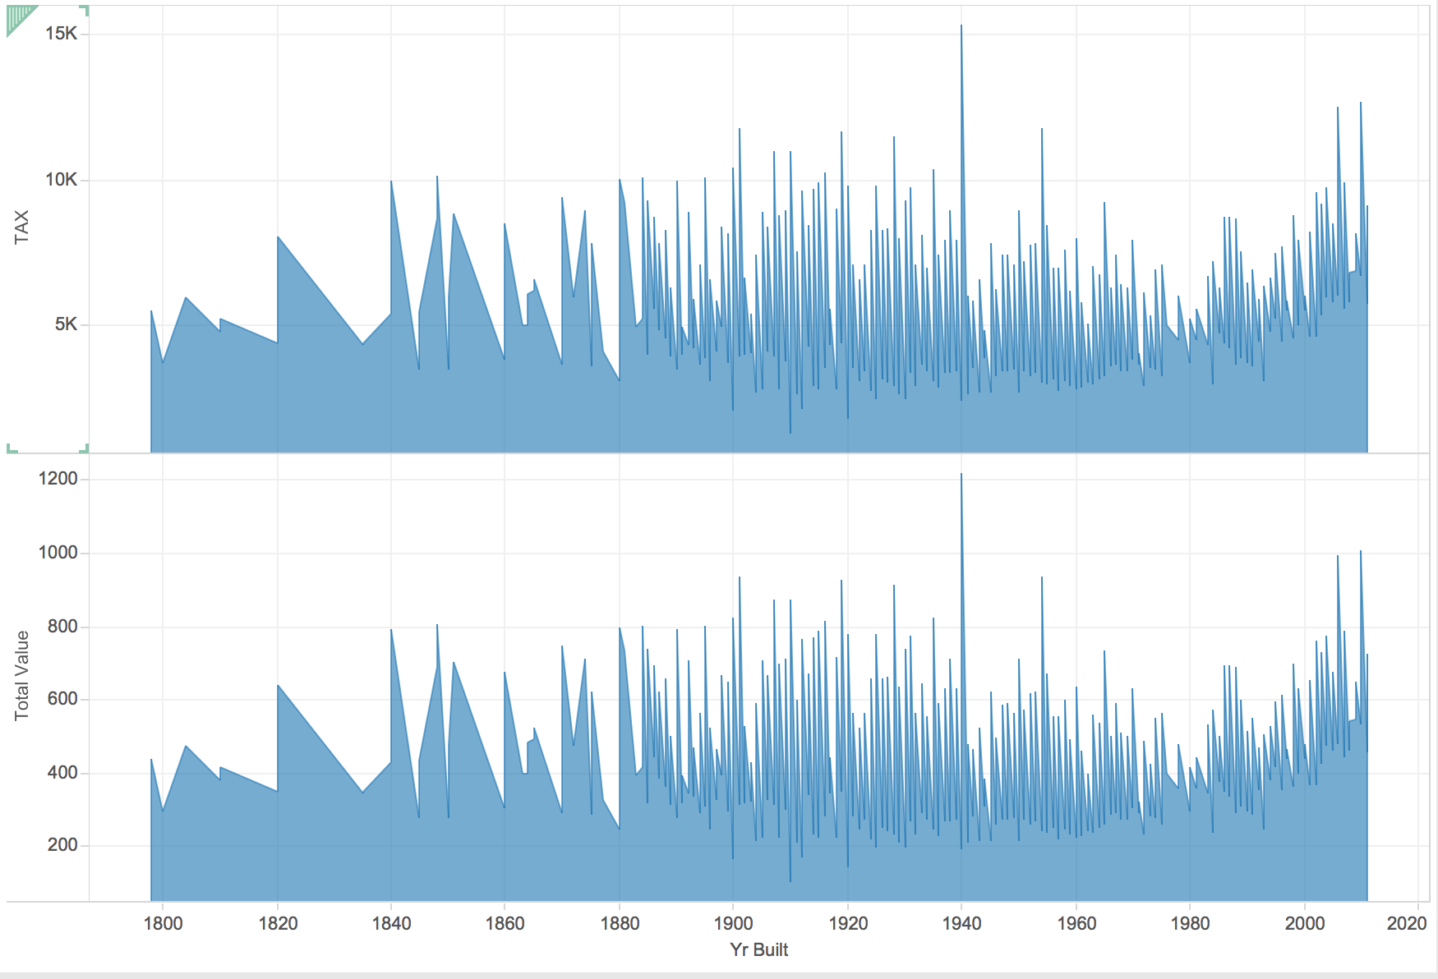
Figure2: Total Value vs Tax considering the year the houses were built
From the figure below we find that year has no significant relationship in predicting the total value of the house.

Slide 4
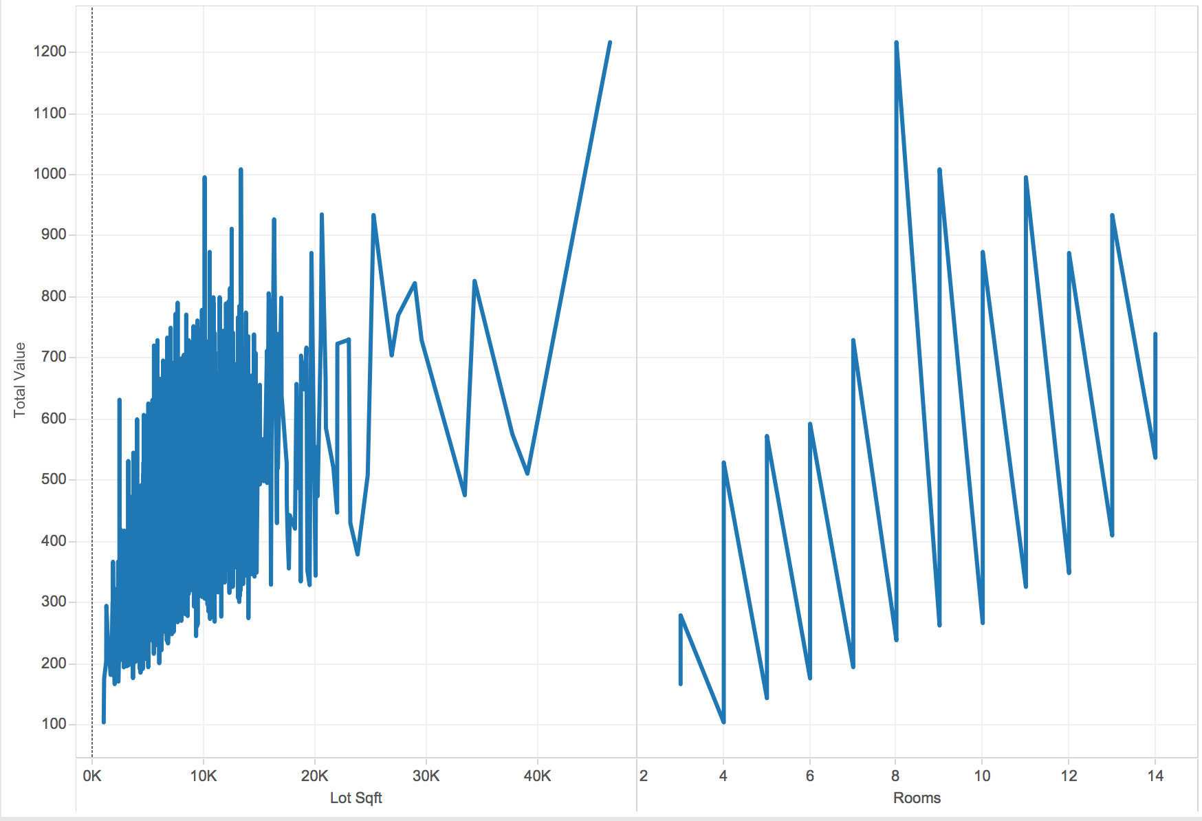
Figure 3: Total Value vs the area in square feet and the number of rooms
The graphs below shows the relationship between the area in square feet and the total value. It is not necessary for the total value of the house to high if the area is more. Similarly is not required for the total value of the house to be more if the number of rooms are more.

Slide 5
Random Forest
AOC= 1.19827e+009
RMSE= 21.102
RROC curve

Slide 6
Multiple Linear Regression
AOC = 1365.45
RMSE = 0.02254
RROC curve

Slide 7
CART
AOC = 1.42429e+009
RMSE= 22.614
RROC curve

Slide 8
Conclusion
From the below observations we recommend that Random Forest to be the best model for prediction of the total value of the houses in the West Roxbury Dataset with lower AOC and RMSE values.
Multiple Regression Model is not chosen as the best because the problem of overfitting could have occurred and its Area over curve value is significantly higher compared to CART and Random Forest.

Slide 9
Problem 2

Slide 10
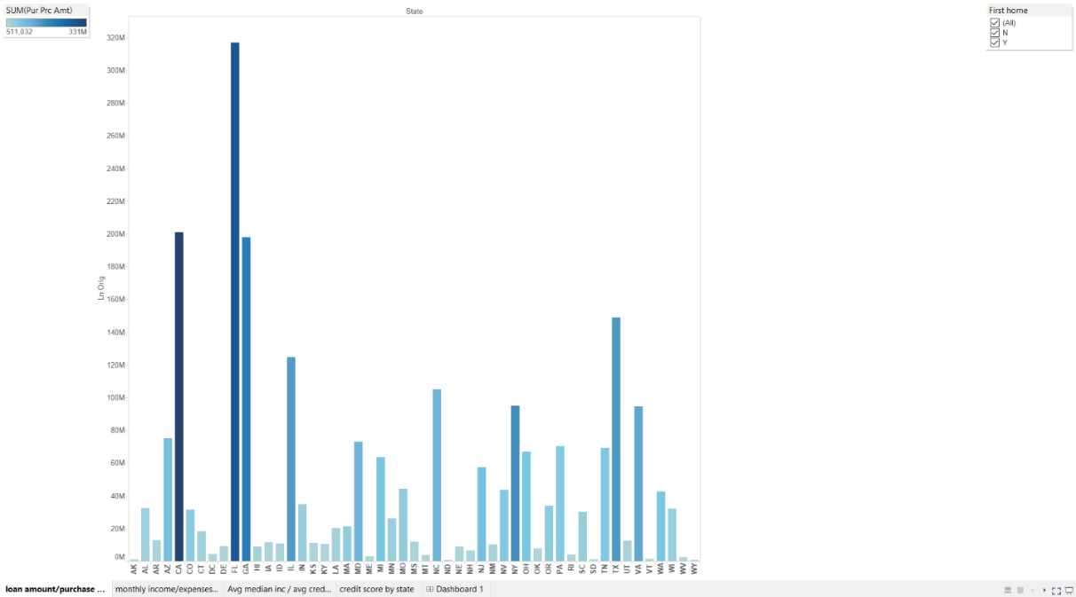
Loan amount & purchase amount by state
This bar graph shows value of loan and sum purchase amount of home by different state. From this graph we can clearly determine which state have highest loan amount and purchase amount. In this graph Florida State approved largest loan amount and also have highest purchase amount of home. There is also filter of whether it is their first home or not. By this you can analyze amount of loan in particular state approved for first home buyers.

Slide 11
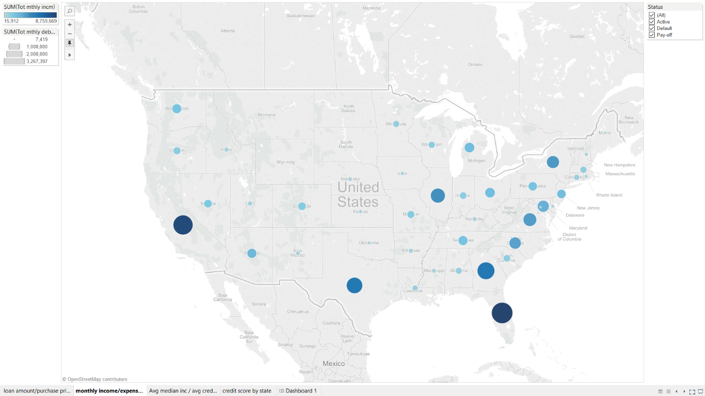
Monthly income & Monthly expenses by states
From this Geo map we can determine total monthly income & expenses of people who have taken loan. From map we can clearly determine that people in Florida have maximum monthly income & also have maximum expenses. There is also filter of status by which can filter data. You can filter data by active, pay-off, default.

Slide 12
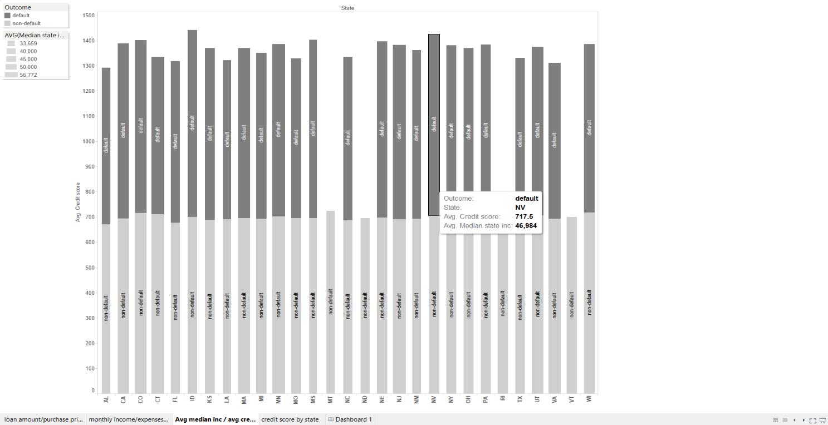
Avg. credit score and Avg. median state income by state
In this graph we can analyze average credit score and median state income by state. We can also determine average income and credit score for defaulter and non-defaulter.

Slide 13
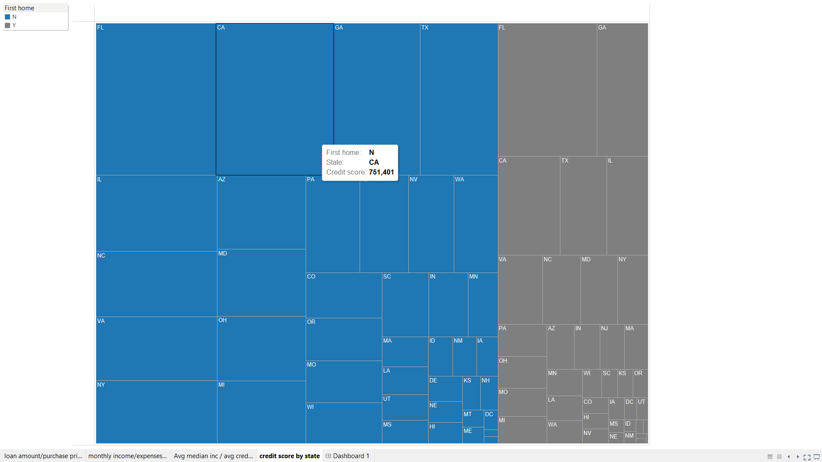
Credit scored by state
This heat map shows credit card scores of people in different states. Also classify heat map by whether people buying their first home or not. You can determine in which state people having highest credit score. So people in Florida having highest credit score in both (First home Y/N).

Slide 14
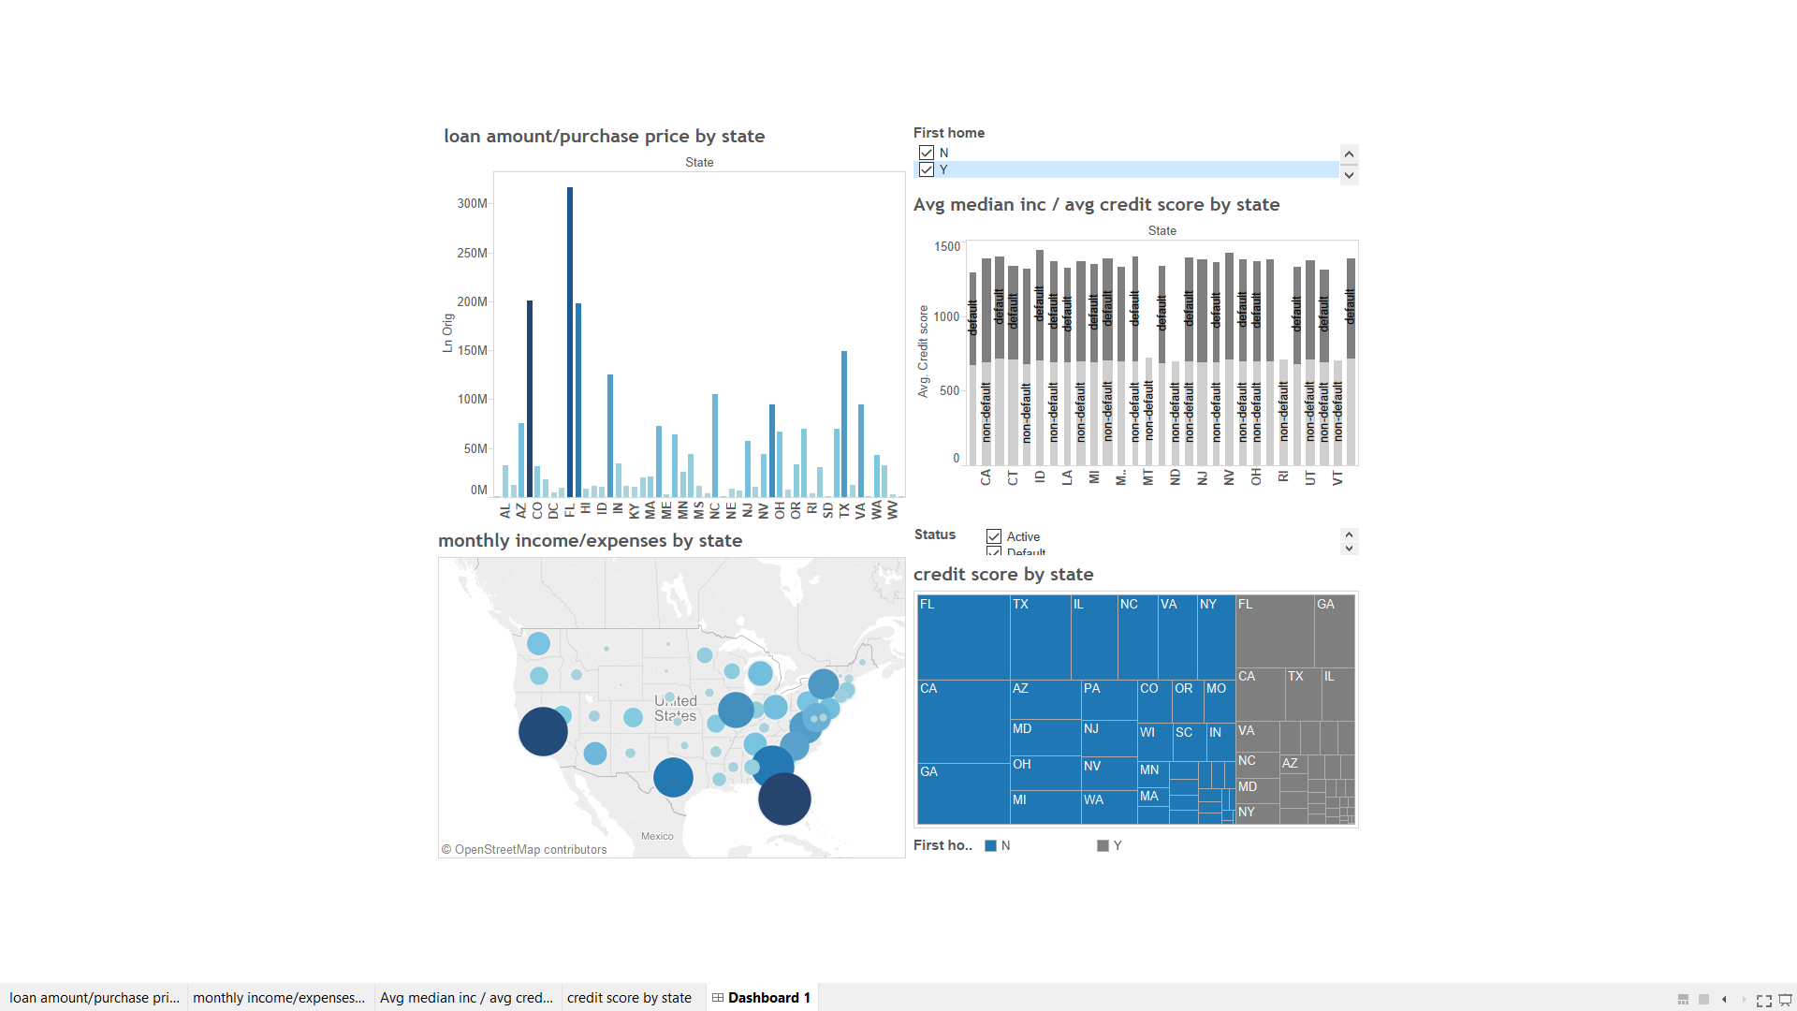
Dashboard

Slide 15
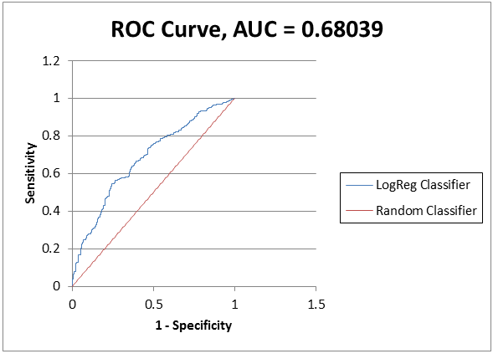
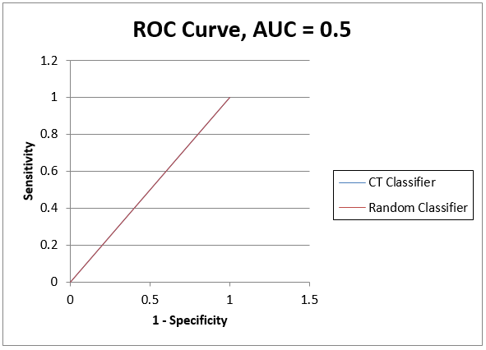
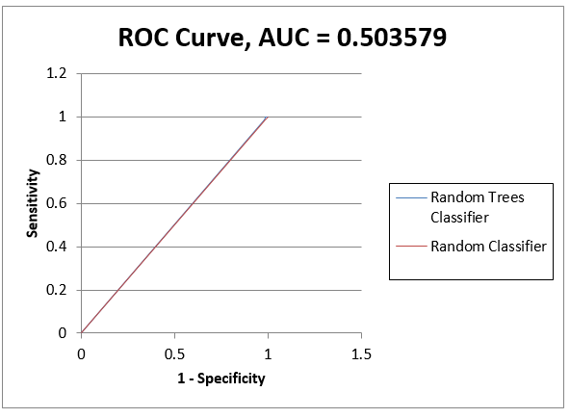
Analysis Using XLMINER
We did analysis using xlminer for logistic regression, cart and random forest we found logistic regression is best algorithm for this dataset
Logistic Regression Cart Random Forest
As you can see curve for logistic regression closer to upper left corner and AUC value for logistic regression is maximum. So I suggest logistic regression model for Mortgage Defaults dataset. If we compare error report for each model for validation data is almost same, so I use ROC curve for model selection.

Slide 16
Problem 3

Slide 17
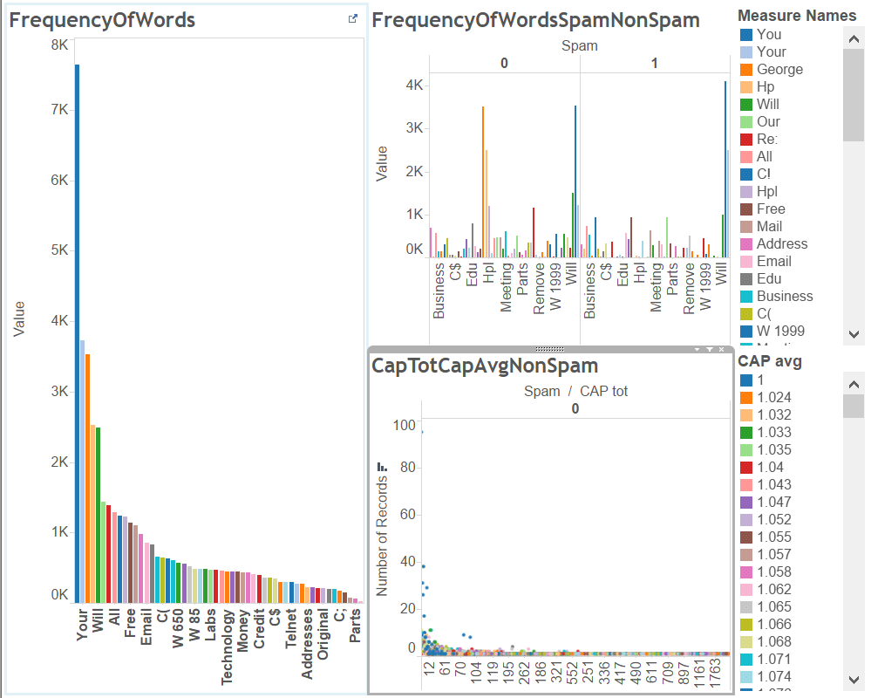
Exploratory Analysis of Spam Dataset

Slide 18
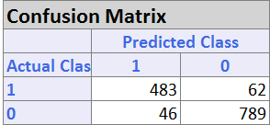
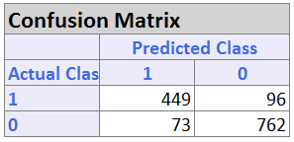
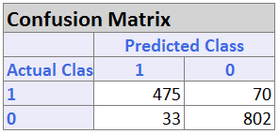
Confusion Matrix
Logistic
CART
Random Forest

Slide 19
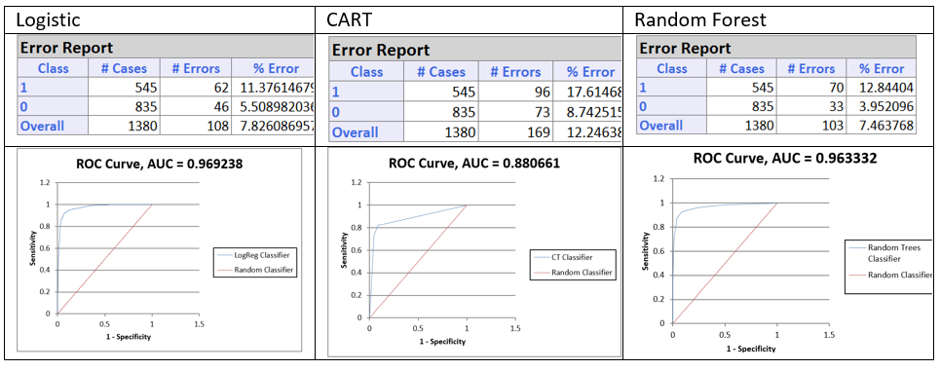
Comparison of the 3 Algorithms

Slide 20
Problem 4

Slide 21
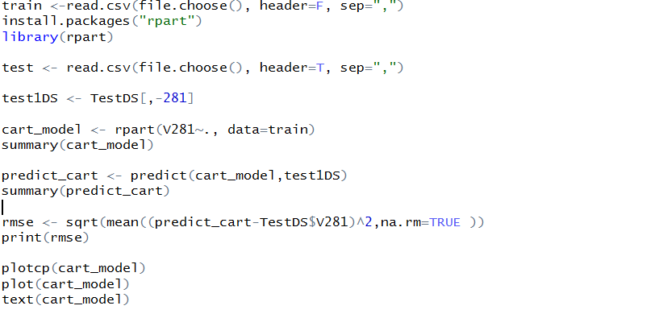
CART (R Code)

Slide 22
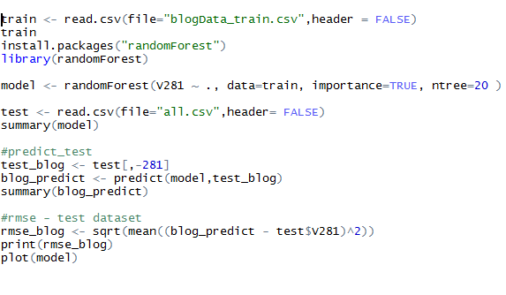
Random Forest(R Code)

Slide 23
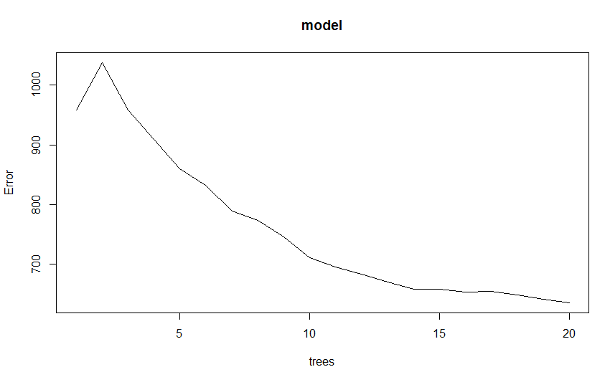
RMS Graph

Slide 24
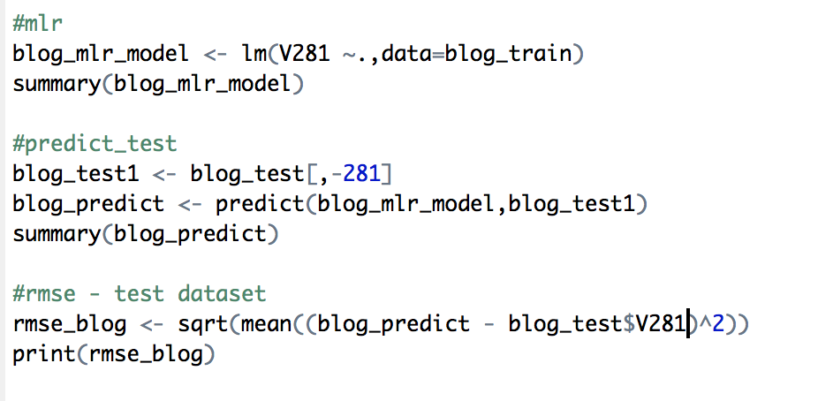
Multiple Linear Regression

Slide 25
RMSE value
#rmse - test dataset
rmse_blog <- sqrt(mean((blog_predict - blog_test$V281)^2))
print(rmse_blog)
[1] 25.44774

Slide 26
Conclusion
Random Forest RMSE: 23.399
CART RMSE: 24.388
Multiple Linear Regression RMSE: 25.447
From the above RMSE values we conclude that Random Forest is the best model for prediction of the number of comments in the next 24 hours.

